Slide 1
Precise Regional Forecasting
via Intelligent and Rapid Harnessing of
National Scale Hydrometeorological Big Data†
Led by
Nian-Feng Tzeng, University of Louisiana, Lafayette
AND
13 investigators from 6 universities in 4 States + USGS
†
Project PREFER funded by National Science Foundation for $5.0M, 9/2020 − 8/2024.
2/6/2024

Slide 2
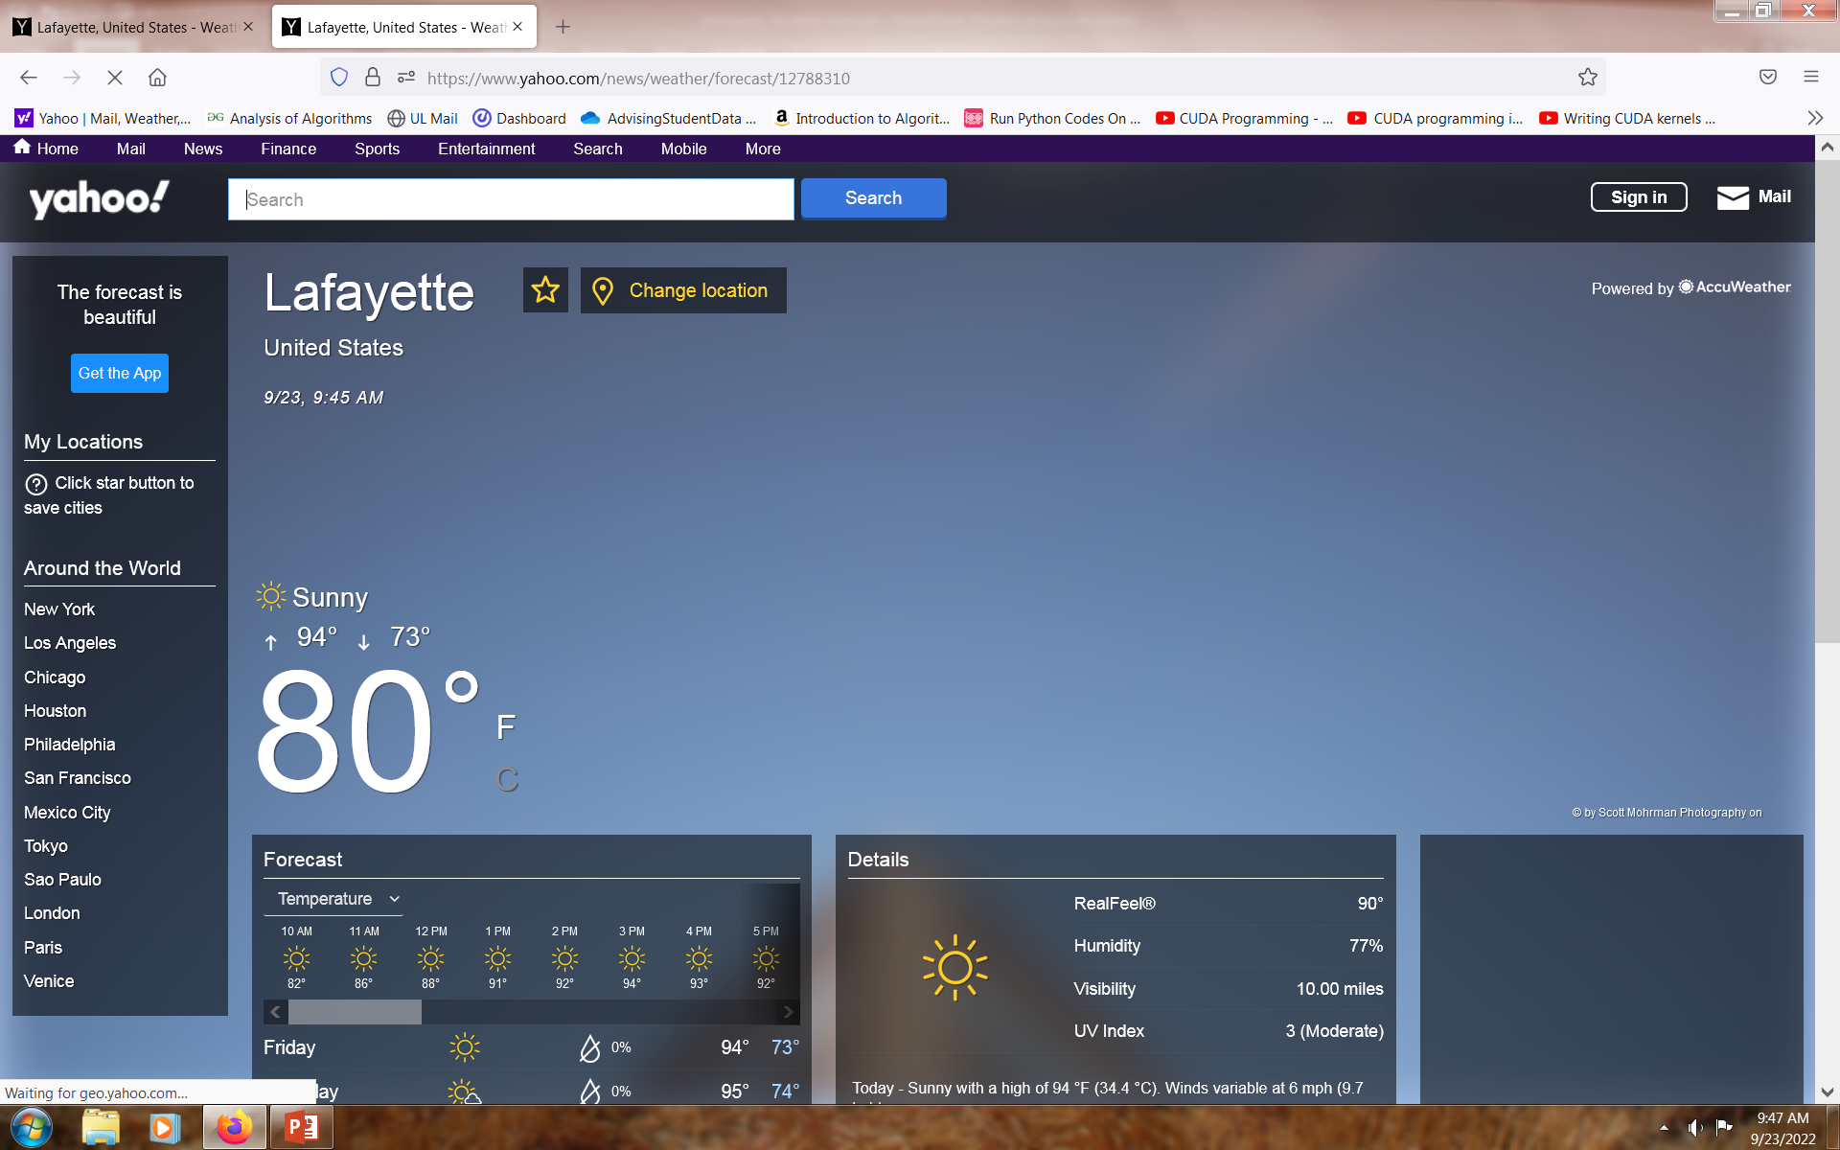
Lafayette Weather Forecast (like AccuWeather)

Slide 3
Forecasters have access to
  satellite imagery
  Doppler radar data
  ground observation stations
  atmospheric models

Slide 4
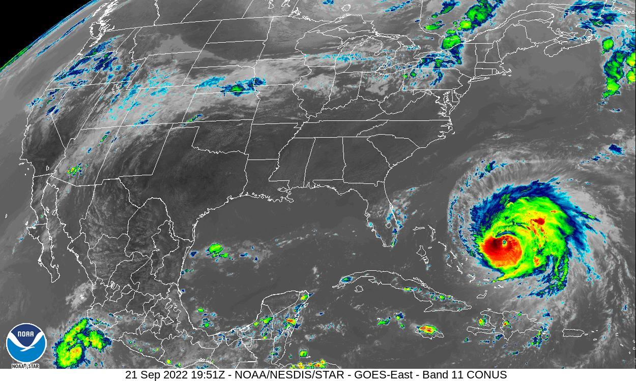

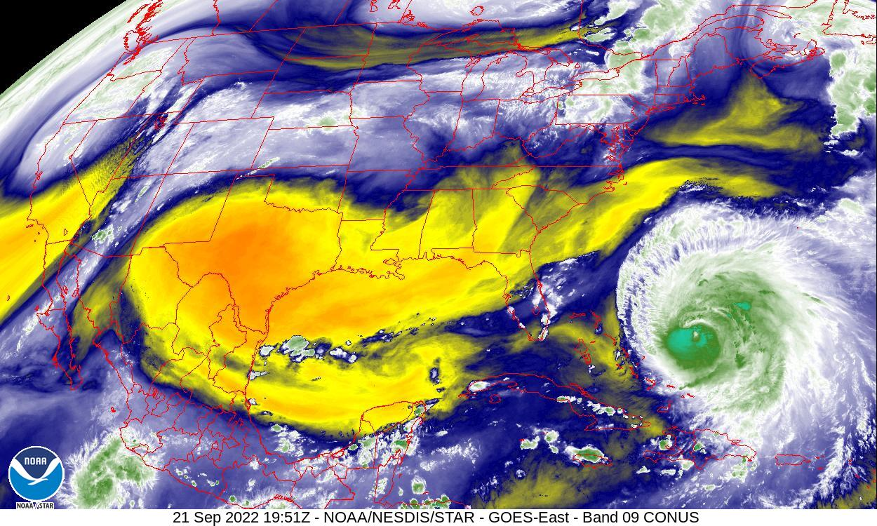
NOAA GOES-16
Satellite Imagery
Band 11 for “Cloud-Top Phase”
Band 09 for “Mid-Level Water Vapor”

Slide 5
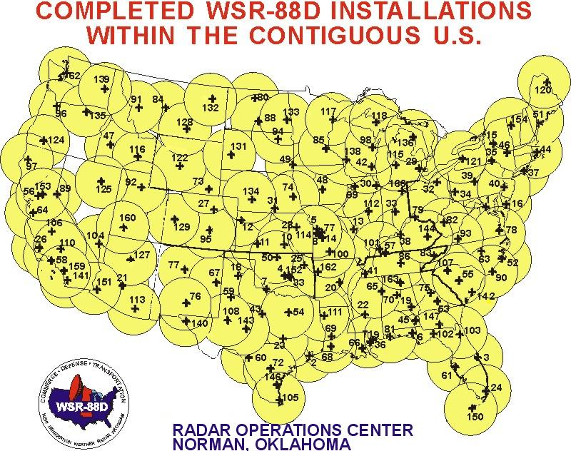
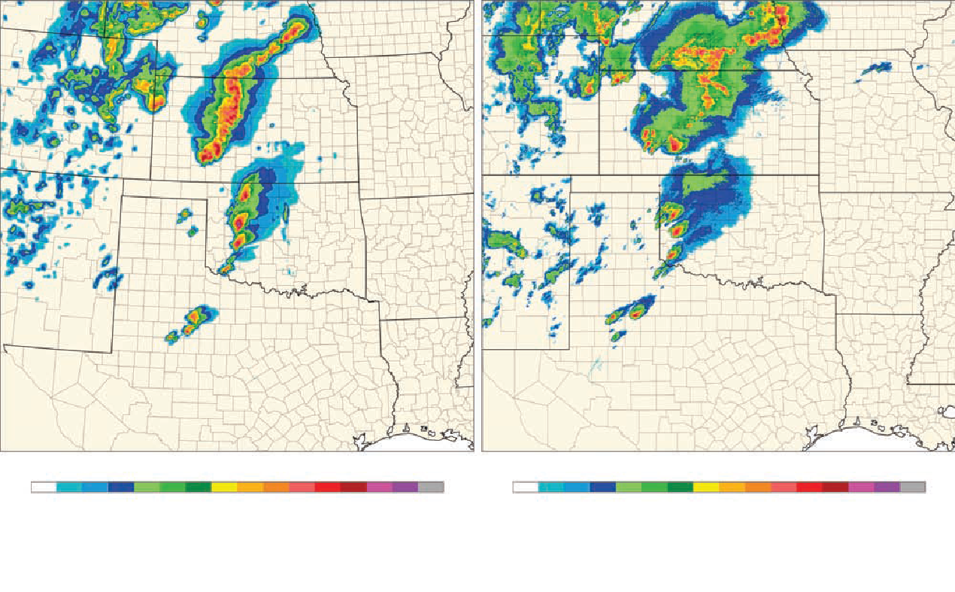
Doppler Radar
• Doppler radar network covers 48
contiguous United States.
• It provides information on rain,
snow, sleet, hail, etc.
t pings of destructive windstorms and tornadoes.

Slide 6
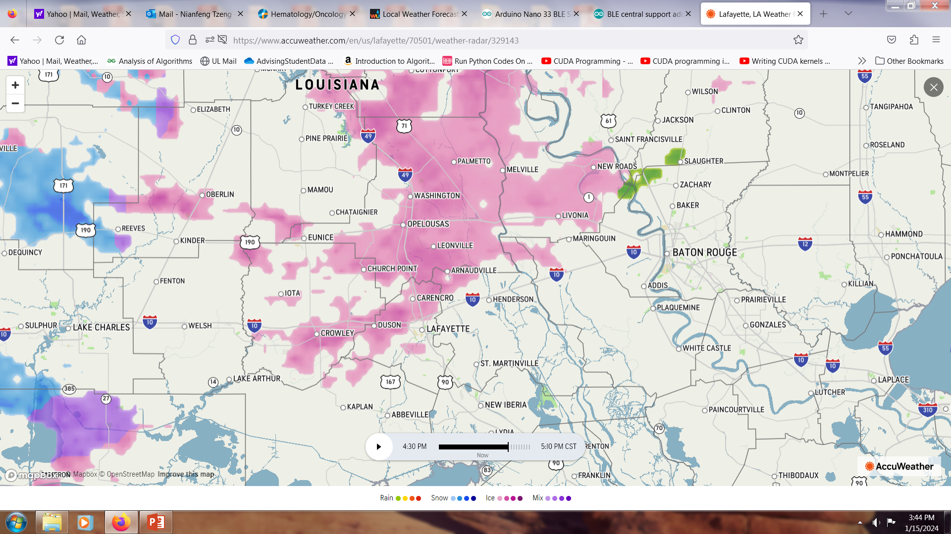
Radar Image over Lafayette, LA at 4:30pm on January 15, 2024

Slide 7
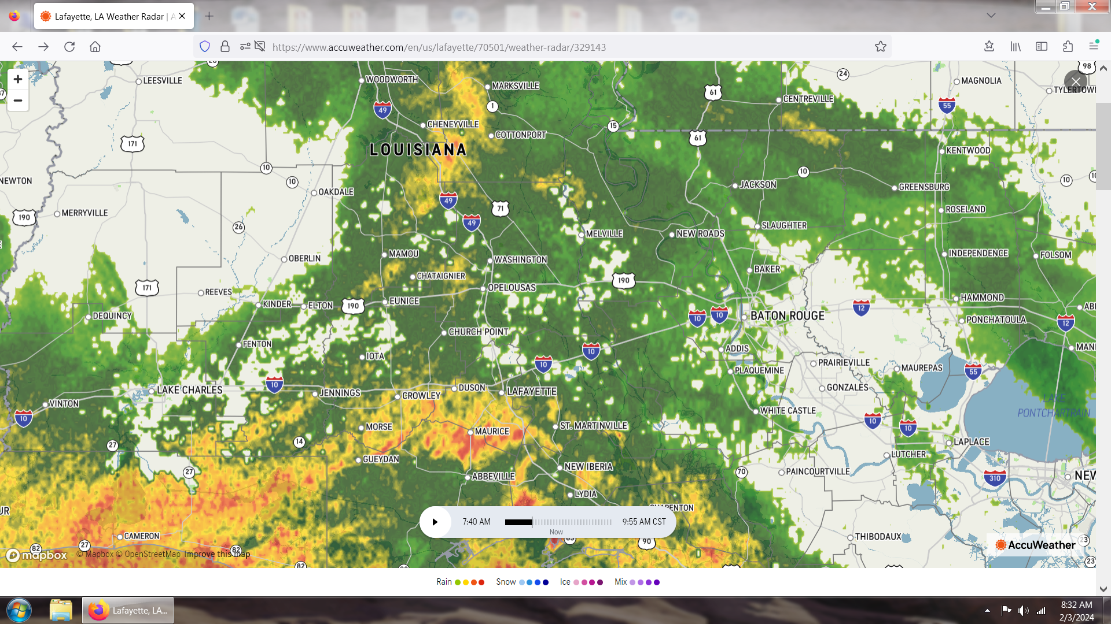
Radar Image over Lafayette, LA at 7:40am, February 3, 2024

Slide 8
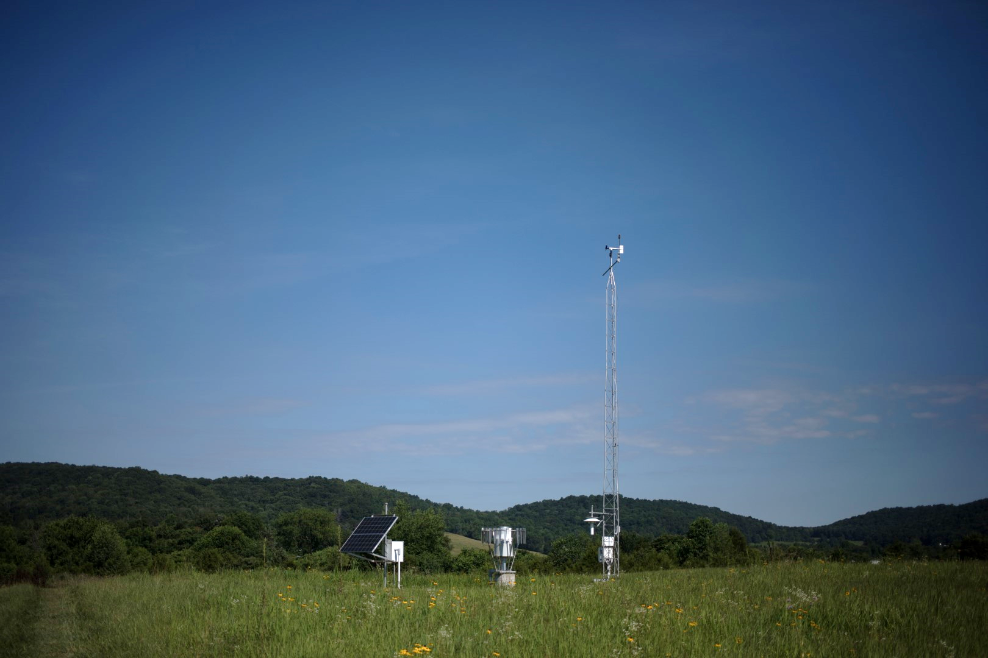
Mesonet Instrumentation Suite
Instrumentation Measures
Air temperature
Precipitation
Solar radiation
Relative humidity
Wind speed & direction
Barometric pressure
Soil moisture & soil temperature
Multi-level temperature and wind speed
Landscape/weather camera imagery
+10 m
+9.0 m
Standard
Atmosphere
+1.5 m
+0.5 m
-5 cm
0 m
-10 cm
Soil
-20 cm
-50 cm
-1 m
-100 cm
Notes:
These are 10m towers outfitted with sensors to measure standard weather variables at all stations, such as:
Enhanced stations measure:
Standard weather variables are measured every 1 minute and returned to the Mesonet Operations Center in Bowling Green every 5 minutes via cellular communications.
In times of active weather, data collection frequency can be modified to observe the 3-second sample, providing a real-time view of the conditions.
Siting: Kentucky struggles for a “perfect” station by World Meteorological Organization standards. Try to find a location representative of the area. Also, when considering locations, take not only the direct surroundings into account, but also possibility of land use change.
Key thing to note here is the adherence to WMO standards.

Slide 9
Sample recording of one Mesonet station

Slide 10
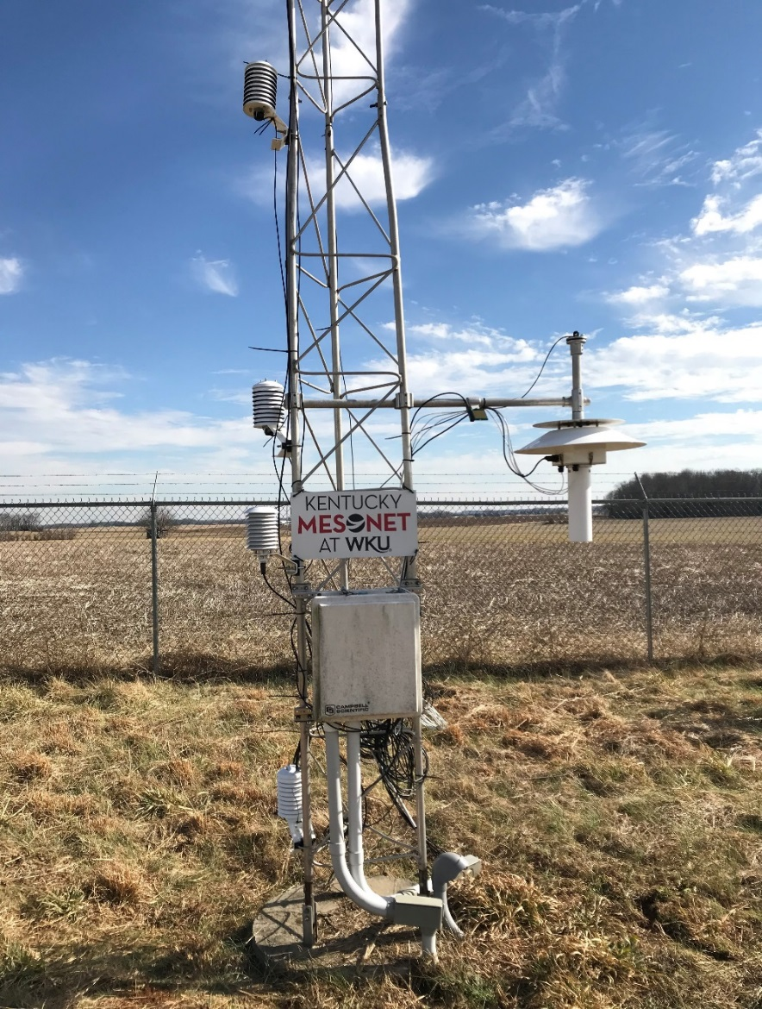
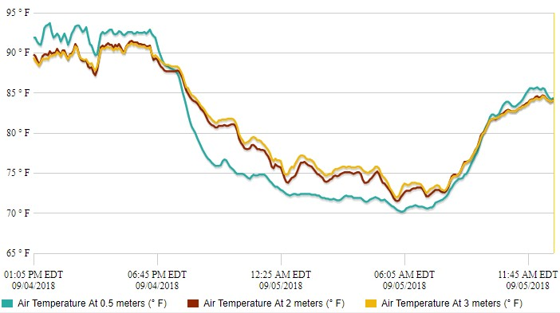
Near-Surface Temperature Monitoring
Expanded temperature monitoring
  • at 0.5m, 2m, 3m
3m
2m
0.5m
Pilot project supported by USDA Midwest Climate Hub
Notes:
What is an inversion
Dicamba
Why important

Slide 11
1. Metrological Prediction
● ML-based prediction utilizing
– Gathered readings of weather stations
– Computed numerical data based on satellite and radar data
● Finer and more accurate weather parameter prediction
– Temperature
– Humidity
– Pressure
– Wind Speed

Slide 12
1.1 Metrological Prediction Models
● Various AI/ML-based models
– Requiring large volumes of quality data
– Training models before use
– Utilizing trained models
● Finer and more accurate weather parameter prediction
– Temperature
– Humidity
– Pressure
– Wind speed

Slide 13
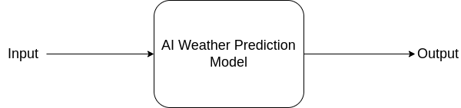
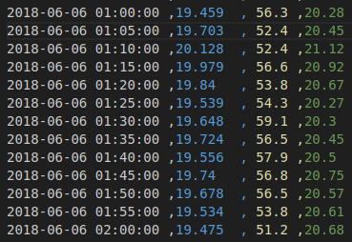
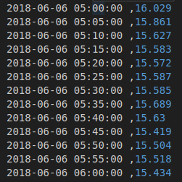
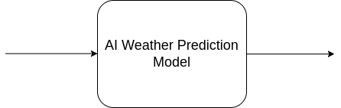
AI/ML-based Weather Prediction Models
Input
Output
(Input is a sequence of weather parameters measured at a 5-minute granularity)
(Output is a predicted weather parameter at some time in the future)
Date/Time
Temperature
Humidity
Date/Time
Temperature
AI/ML-based
Weather
Prediction Model
+4
hours

Slide 14
1.2 Metrological Prediction Results
● Demonstrated via
– Curves
– 2-D mappings
● Finer and more accurate weather parameter prediction
– Temperature
– Humidity
– Pressure
– Wind speed

Slide 15
Model Prediction Results − Temperature

Slide 16
Model Prediction Results − Humidity

Slide 17
Model Prediction Results − Wind Speed

Slide 18

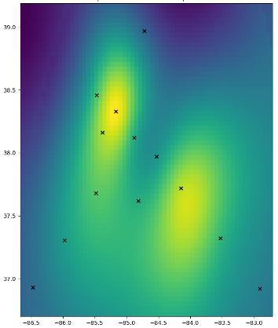
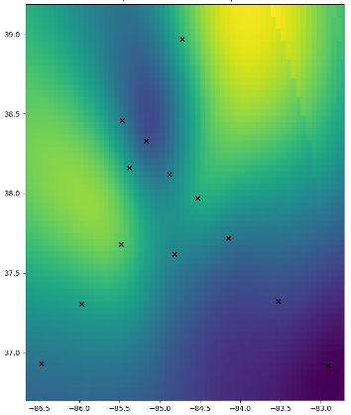
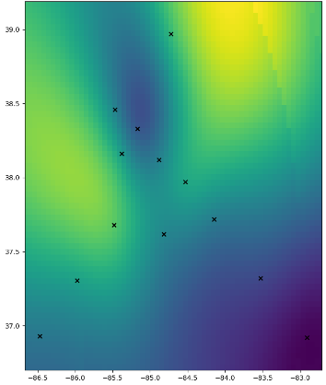
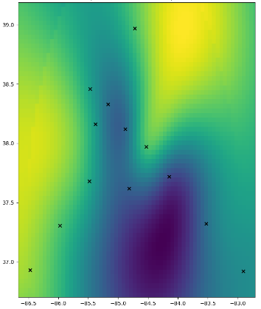
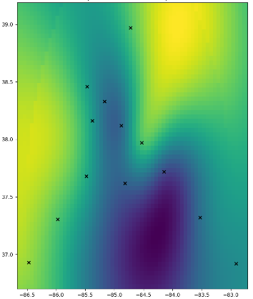
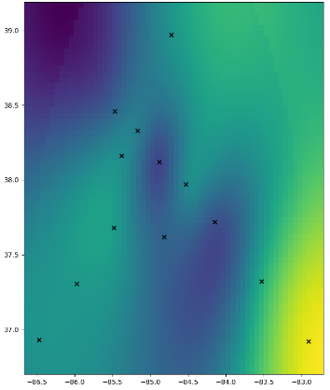
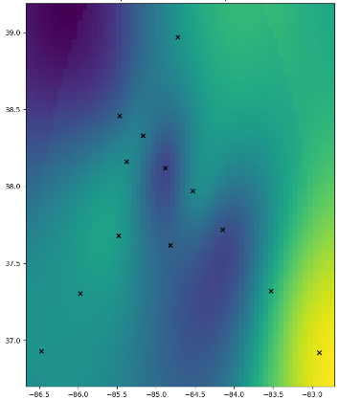
Temperature Prediction (in °C)
Error = 0.031
+3 hours
+3 hours
Input Temperature at 12:00 AM
Ground truth at 3:00 AM
Prediction at 3:00 AM
Error = 0.053
Error = 0.085
+6 hours
Ground truth at 6:00 AM
Prediction at 6:00 AM
Ground truth at 12:00 PM
Prediction at 12:00 PM

Slide 19

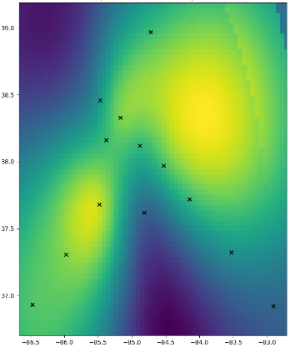
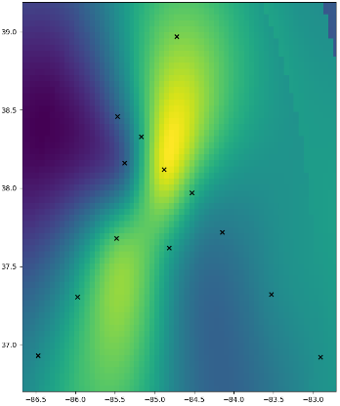

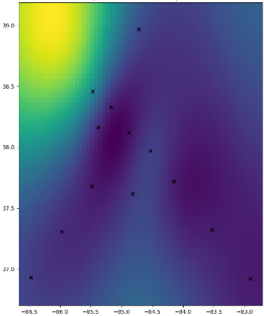
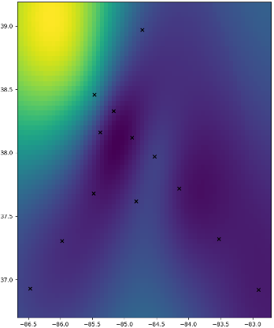
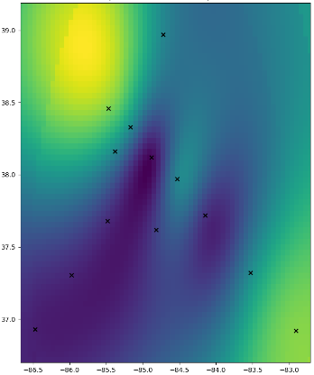
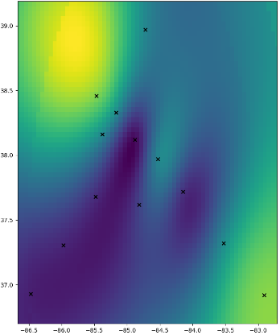
Wind Speed Prediction (in mph)
Error = 0.002
+3 hours
+3 hours
Input Temperature at 12:00 AM
Ground truth at 3:00 AM
Prediction at 3:00 AM
Error = 0.006
Error = 0.010
+6 hours
Ground truth at 6:00 AM
Prediction at 6:00 AM
Ground truth at 12:00 PM
Prediction at 12:00 PM

Slide 20
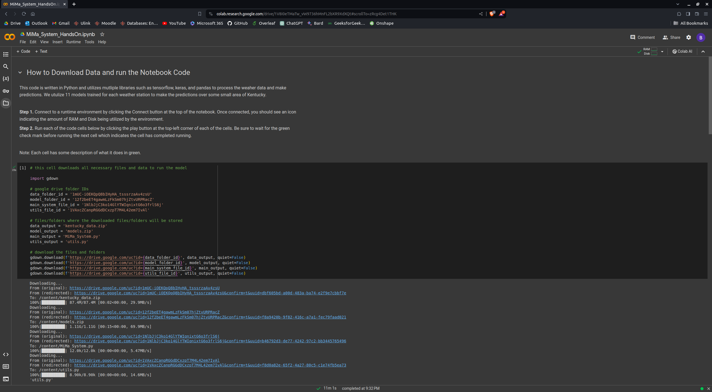
Hands-On Instructions

Slide 21
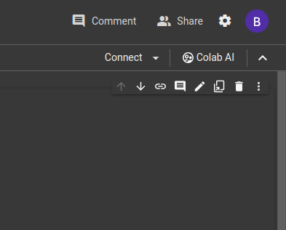

Hands-On Instructions
Connect to the runtime environment

Slide 22
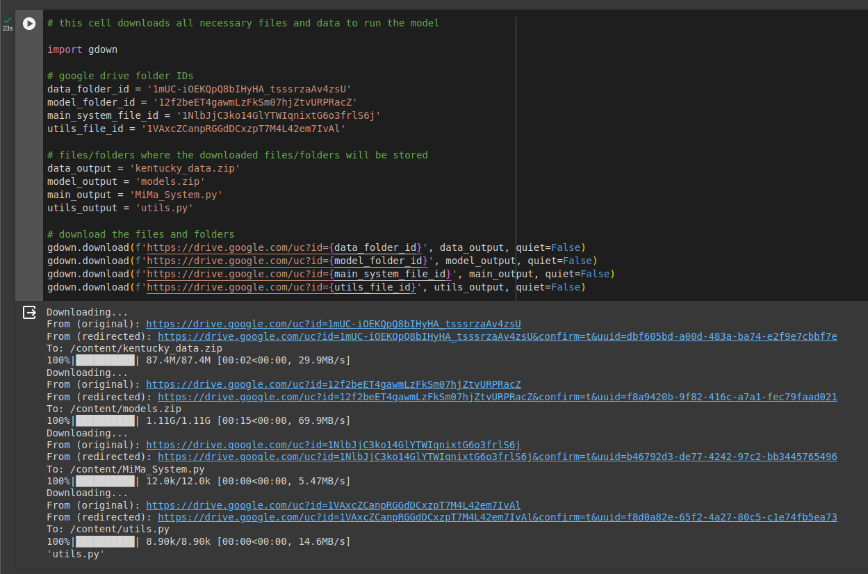
Hands-On Instructions

Slide 23
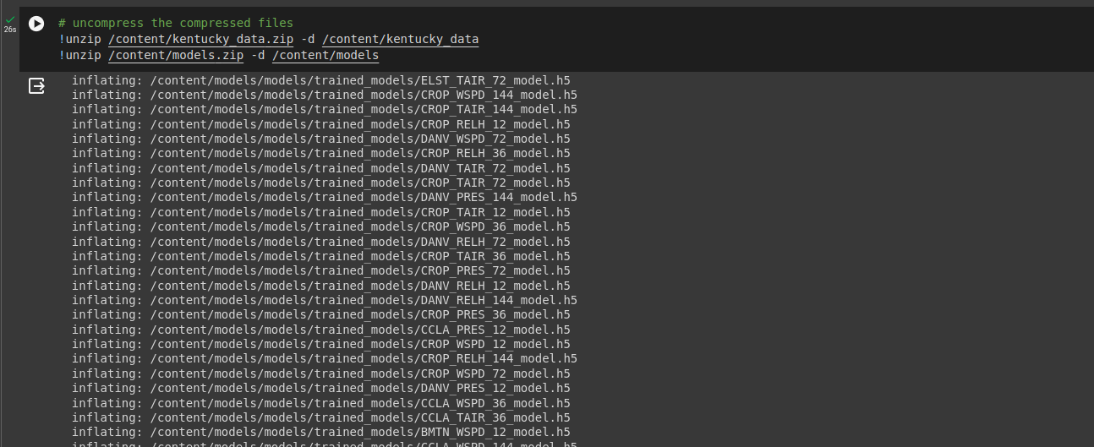
Hands-On Instructions

Slide 24
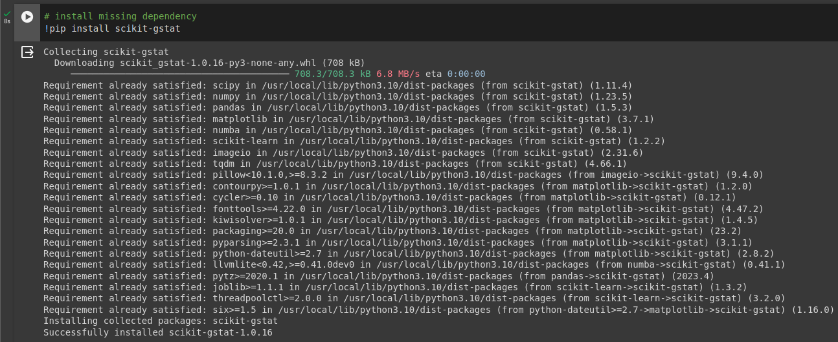
Hands-On Instructions

Slide 25
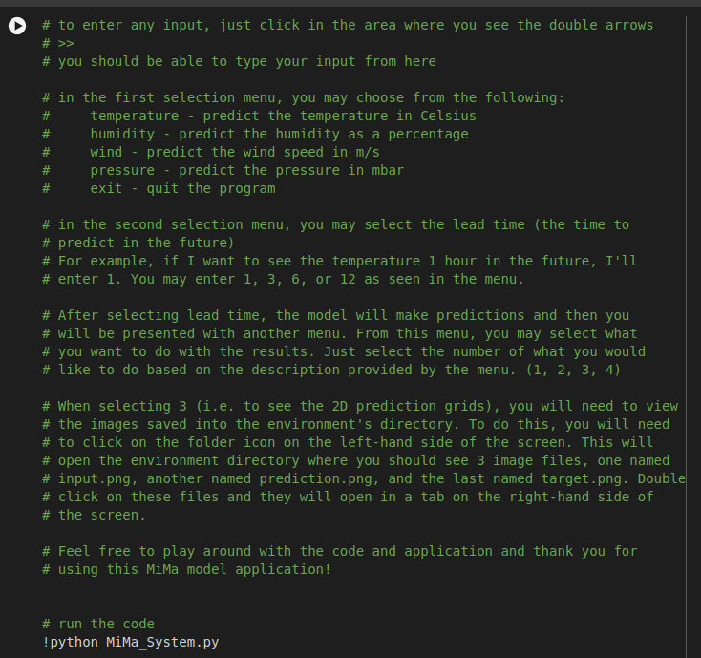
Hands-On Instructions

Slide 26
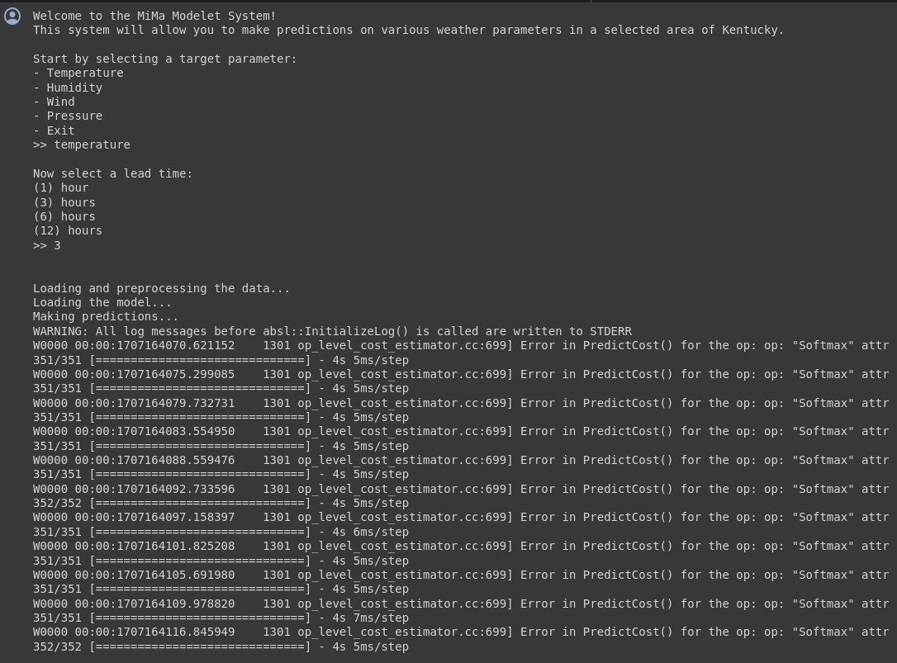
Hands-On Instructions

Slide 27
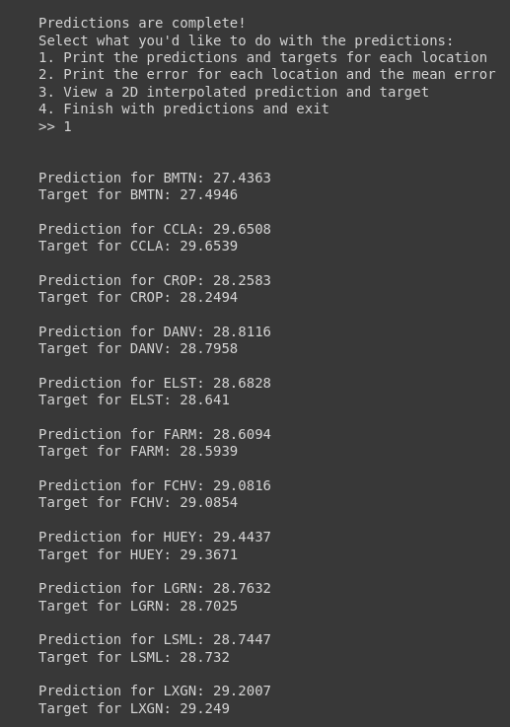
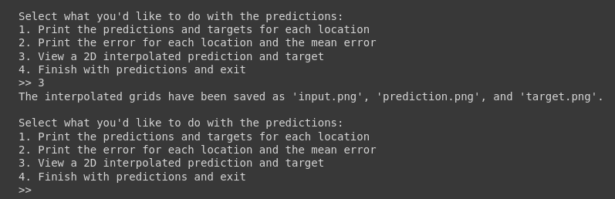
Hands-On Instructions

Slide 28
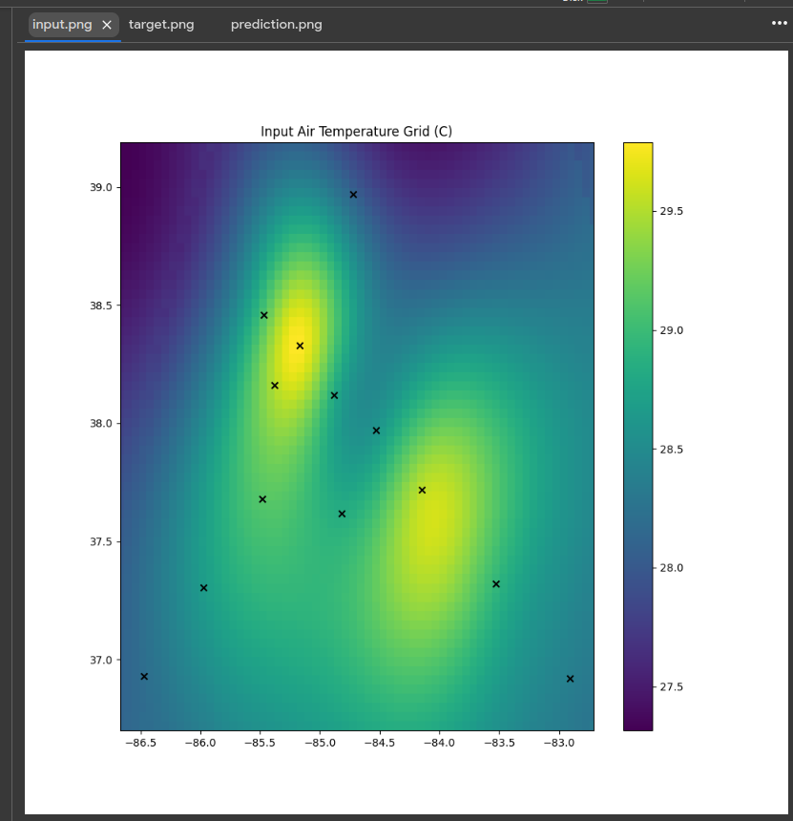
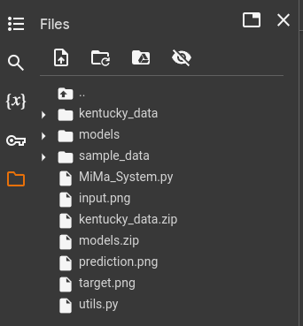
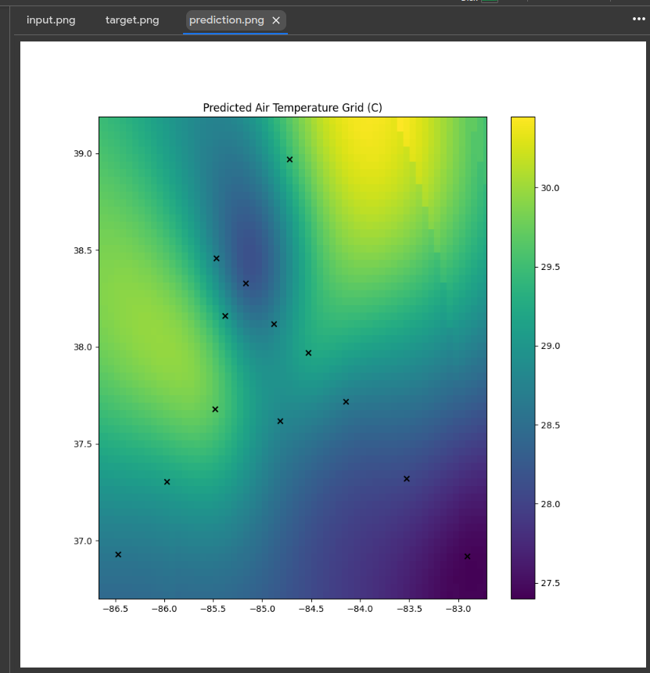
Hands-On Instructions

Slide 29
Precise Regional Forecasting
via Intelligent and Rapid Harnessing of
National Scale Hydrometeorological Big Data†
Led by
Nian-Feng Tzeng, University of Louisiana, Lafayette
AND
13 investigators from 6 universities in 4 States + USGS
†
Project PREFER funded by National Science Foundation for $5.0M, 9/2020 − 8/2024.
2/7/2024

Slide 30
2. Hydrological Prediction
● May 17 – 18, 2021
– Floodwaters after heavy rains led to ≥ 4 deaths and 2,700 damaged homes in five SW Louisiana parishes regionally
● Prediction based on
– Gathered readings of personal weather stations
– Logged data by streamgages deployed by US Geological Survey
– Computed numerical data based on satellite and radar data
● Prediction on
– River water height
– River water flow

Slide 31
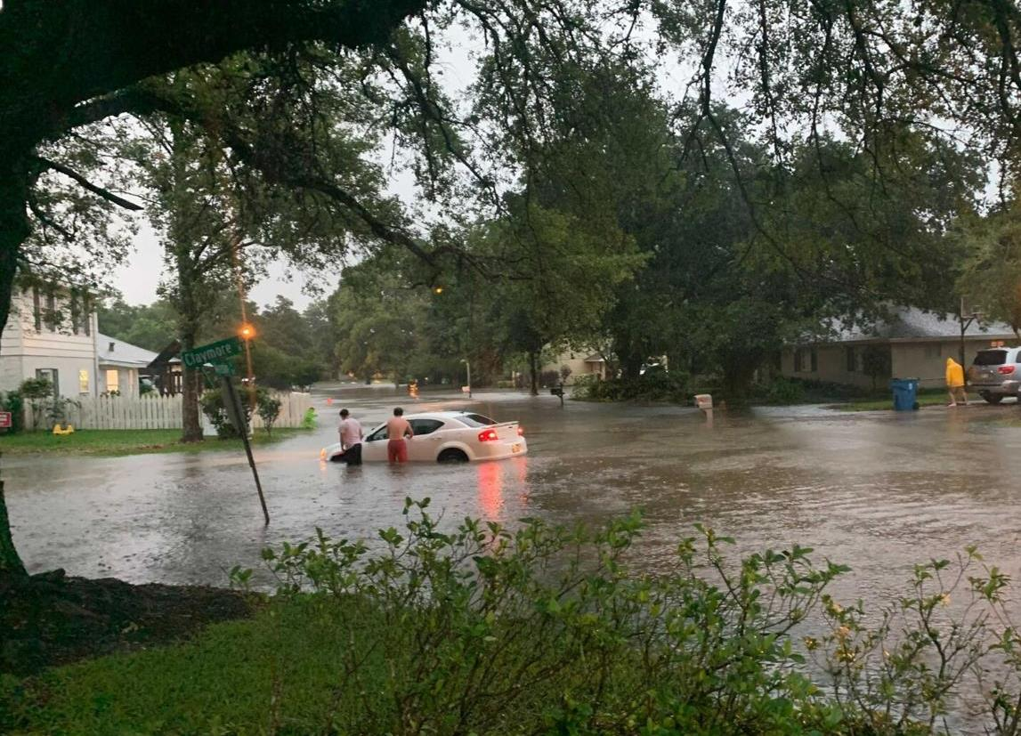
May 17, 2021 in Lafayette, Louisiana

Slide 32
2.1 Hydrological Prediction Models
● Various AI/ML models
– Requiring large volumes of quality data
– Training models before use
– Utilizing trained models
● Accurate prediction
– River water height
– River water flow

Slide 33
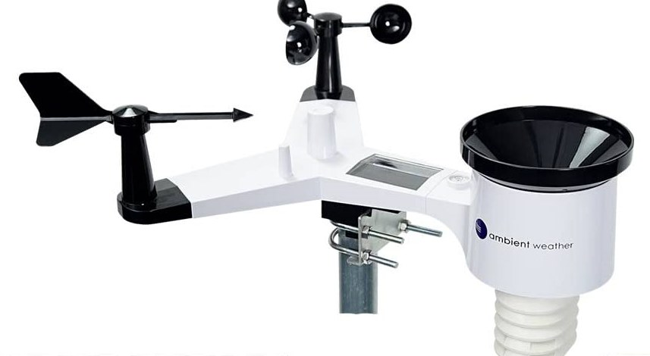
Personal Weather Station − Ambient Weather WS-2902

Slide 34

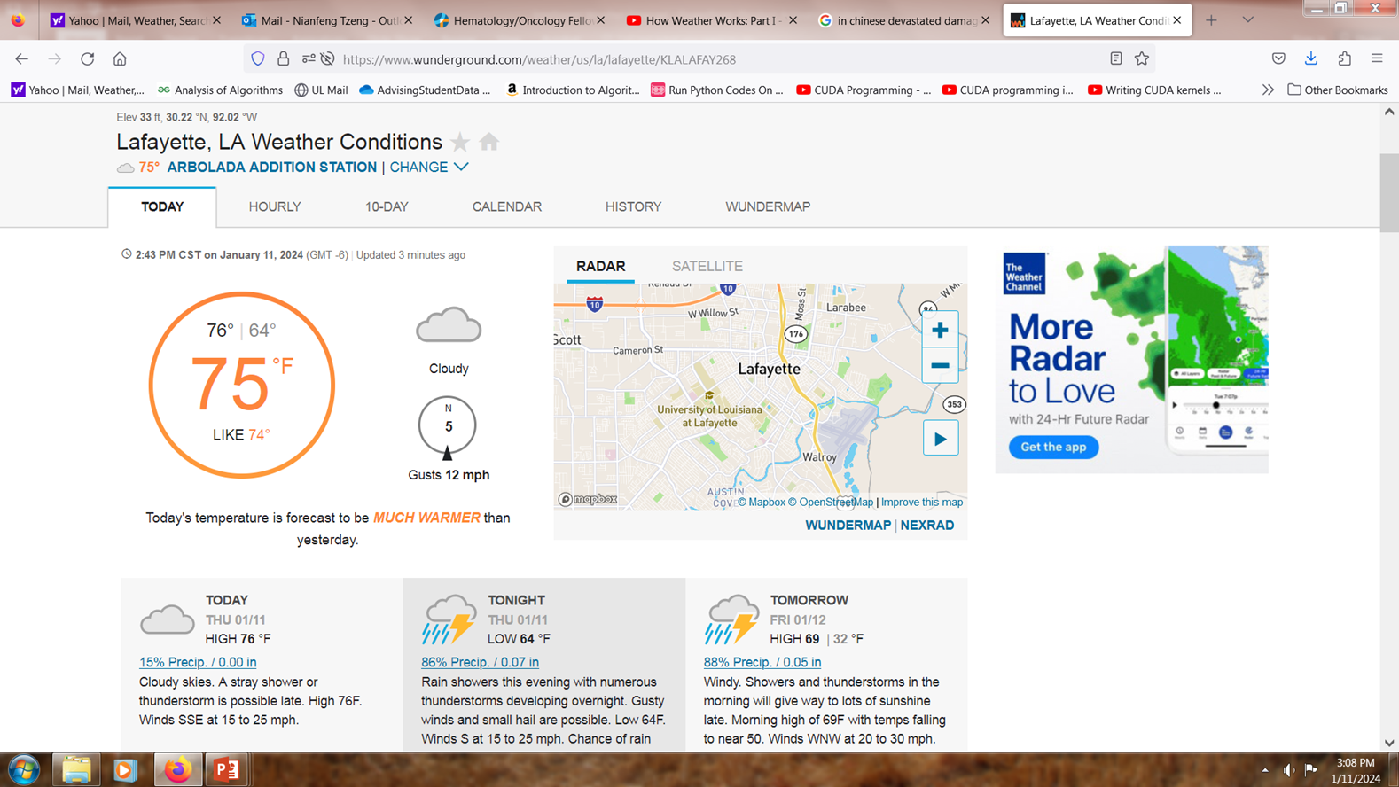
Weather
Underground
3. Research Project Tasks
Task 1: Mesonet Surface Observations
Task 2: Water Gauge Deployment and WRF Data Regriding
Task 3: In-Memory Processing
Task 4: Error Detection and Recovery for Computing Resilience
Task 5: Stochastic Computing
Task 6: GPGPU Support
Task 7: Meteo Modelets with 2-D Inputs
Task 8: Focused Meteorological Problems
Task 9: Focused Hydrologic Problems

Slide 35
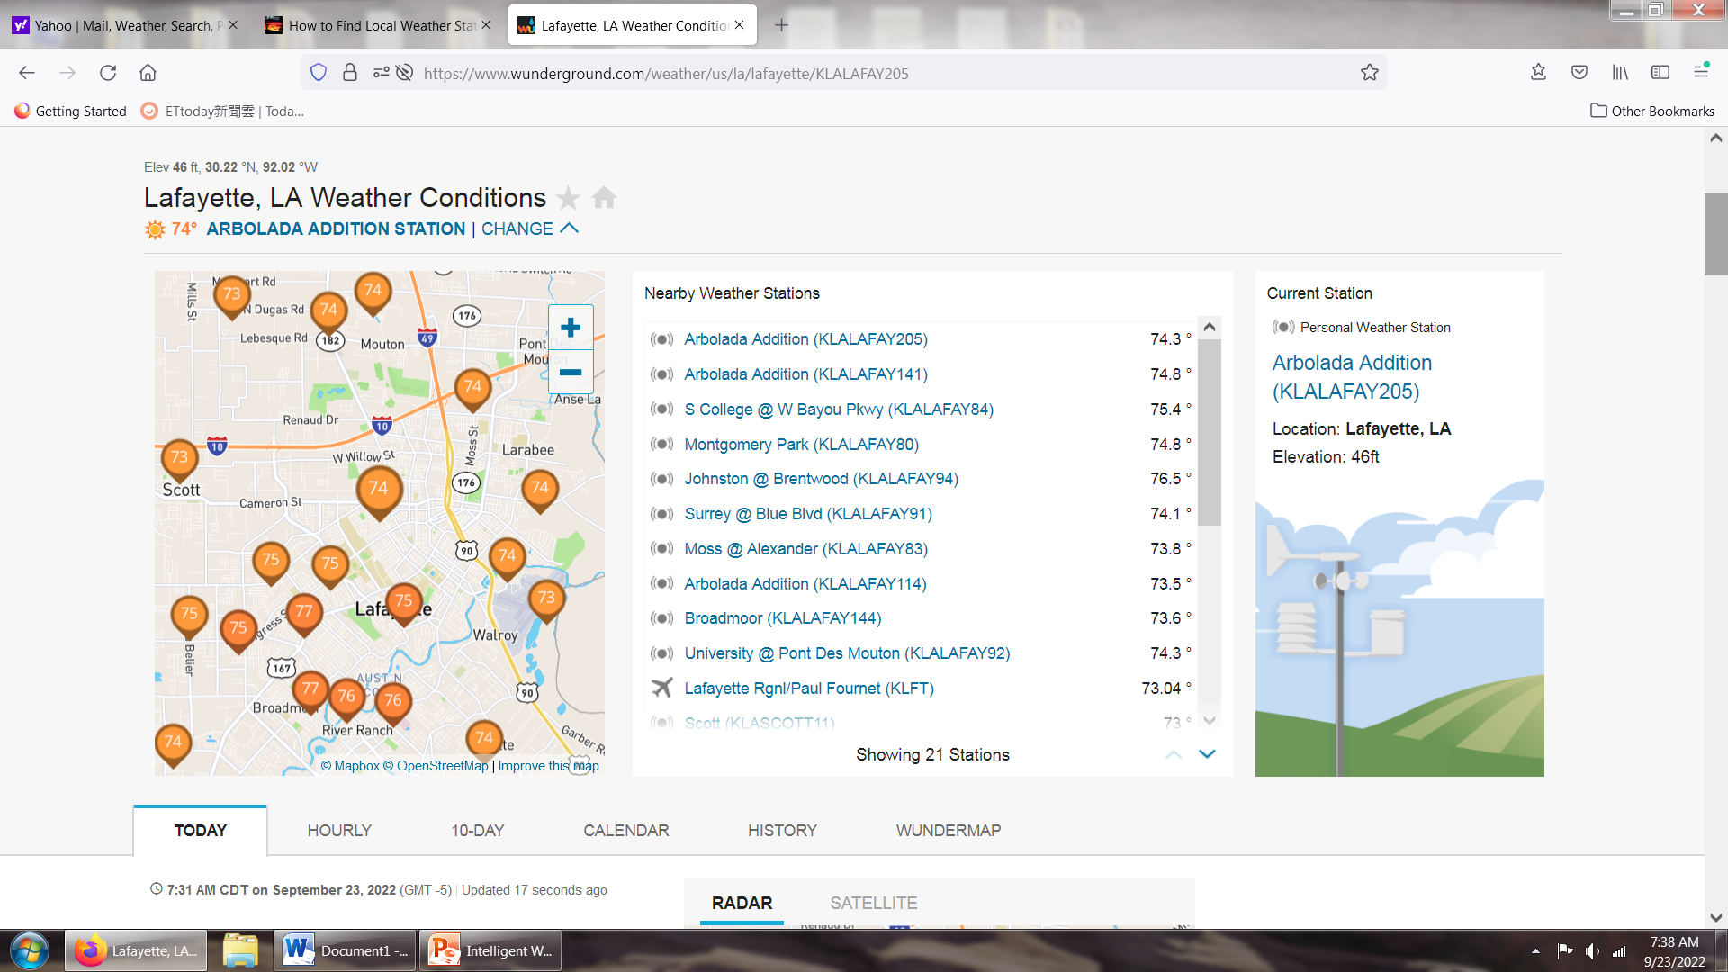
Available Personal Weather Stations in Lafayette

Slide 36
Sample recording of a Lafayette personal weather station

Slide 37
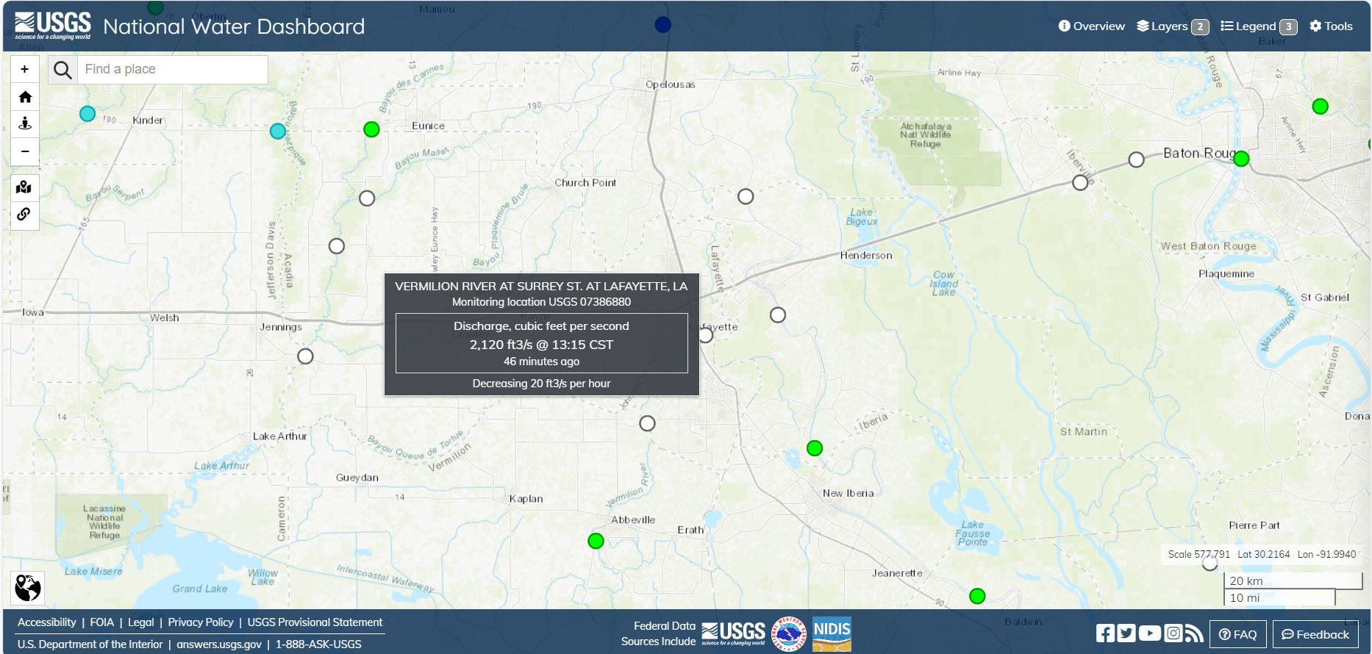
United States Geological Survey Map (Vermilion in Lafayette)

Slide 38
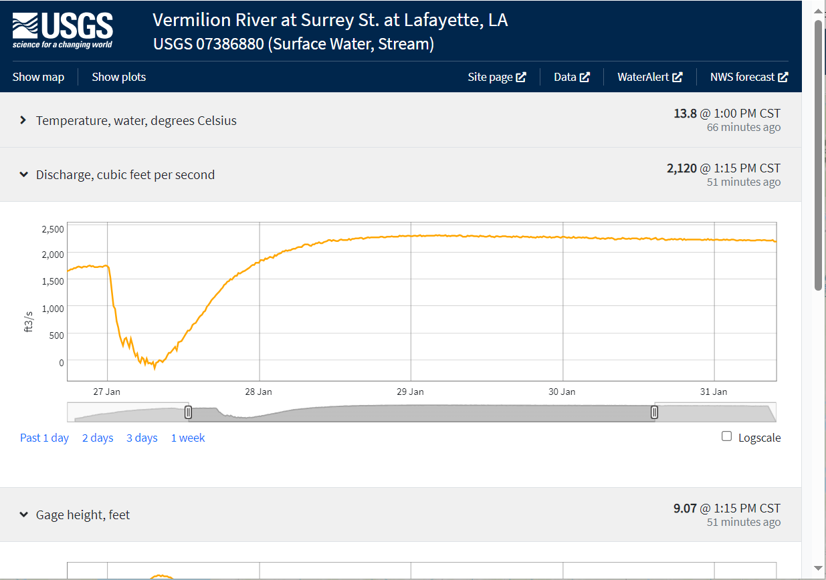

Slide 39
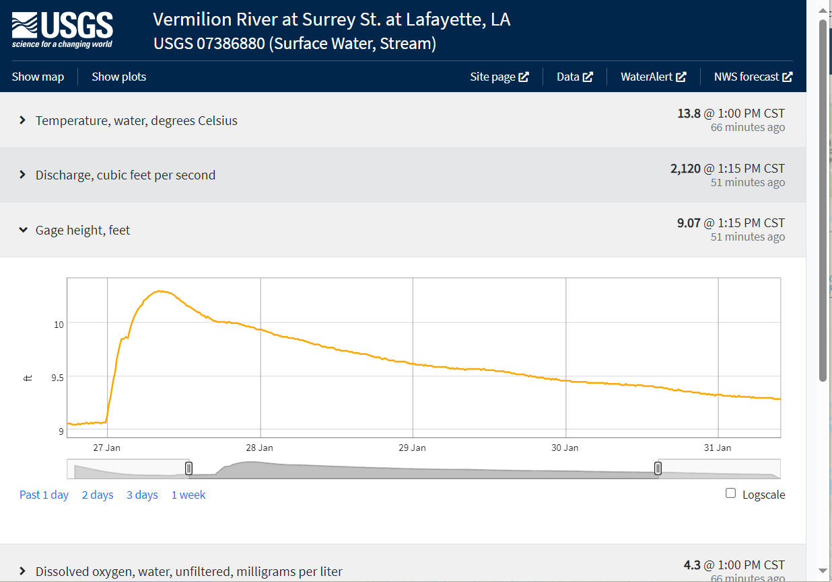

Slide 40
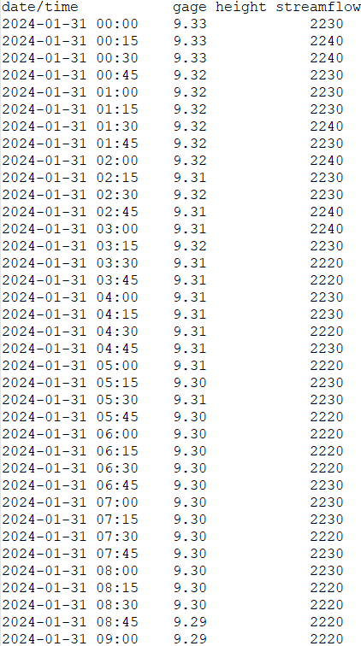
Sample Recording of the Vermilion River in Lafayette at Surrey St.

Slide 41
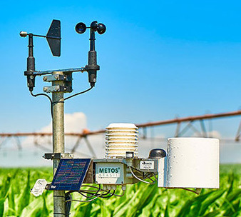

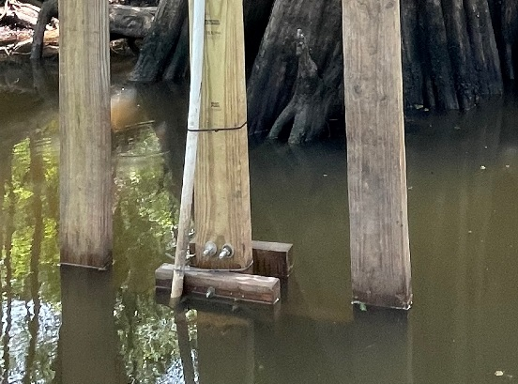
AI/ML-based Hydrological Prediction Models
AI/ML-based
Hydrological
Prediction Model
Input
Output
(Input is a sequence of hydrological parameters measured at a 15-minute granularity)
(Output is a predicted hydrological parameter at some time in the future)
Temperature
Personal Weather Station
Streamgage
Streamgage

Slide 42


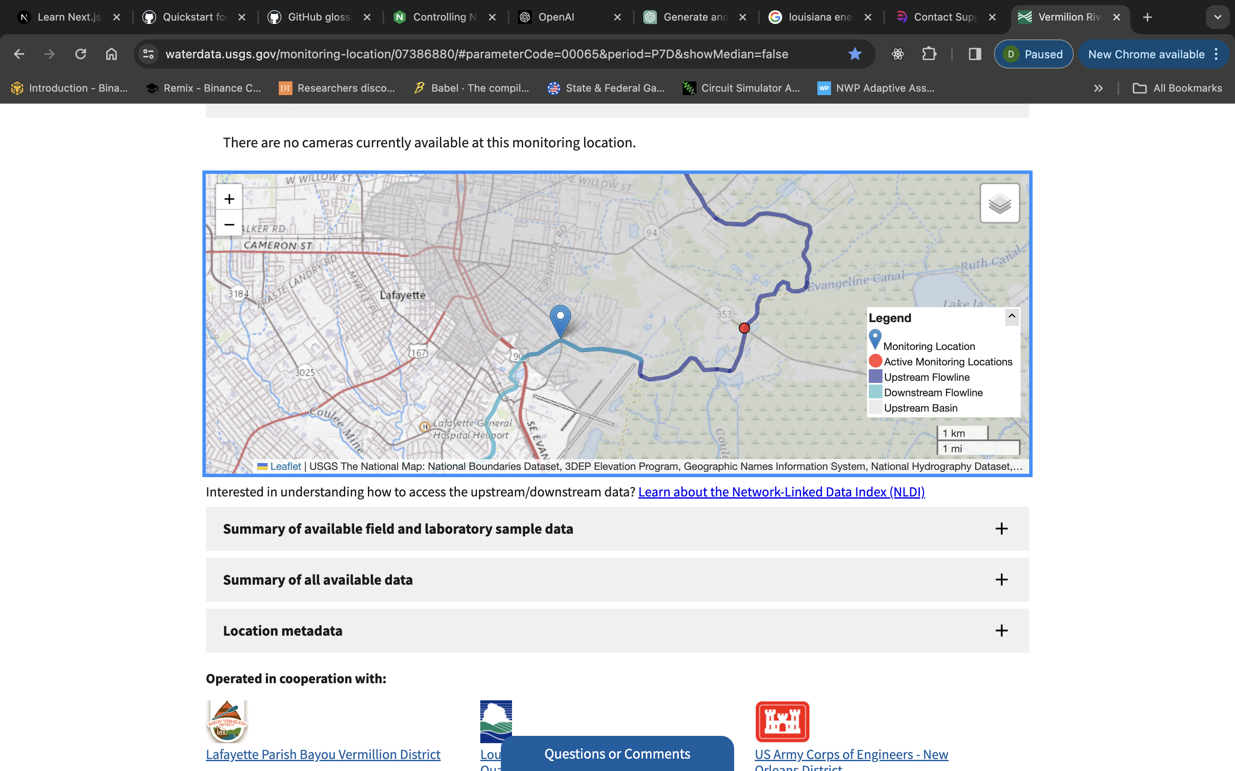
Hydrological Model
Vermilion River Predictions
Hydrological
Prediction
Model
Water level
Flow rate
Parameters:
25 Lafayette Weather Stations:
4 weather parameters per station
Vermilion River gauge readings:
  flow rate and water level
…
...
….
Vermilion River Gauge
Weather Underground
Stations
Vermilion
River
Gauge

Slide 43
2.1 Hydrological Prediction Results
4-hour Lead Time Prediction

Slide 44

4. Conclusion

